Slide 1


DEVELOP PYTHON CODE FOR YIELD PREDICTION
Presented by :
Kaneriya Parth
Kalola Deep
Jivani Parth
Moliya Vatsal

Slide 2
Objective
We have dataset of different weather parameters of past 27 years and meteorological week 44-52 to next year meteorological week 1-11(Rabi season).
By using this dataset we want to build a multiple linear regression model which can predict crop yield.

Slide 3
Data Used
We have data of 7 weather parameters (Weekly average of Rabi season) and yield of wheat of Anand district.
Weather parameters used: Bright sunshine hours (BSS), Maximum Temperature (Tmax), Minimum Temperature (Tmin), Relative Humidity (Rh1,Rh2), Vapour Pressure(Vp1,Vp2).

Slide 4
Methodology
We find 56 features by statistical approach, which can be used in model.
After finding correlation of 56 features with yield, we used top correlated features in multiple linear regression to build yield prediction model.
By, Multiple linear regression we find coefficient and intercept of equation which can predict crop yield.
With help of equation we passed current weather parameter and we predicted crop yield.

Slide 5
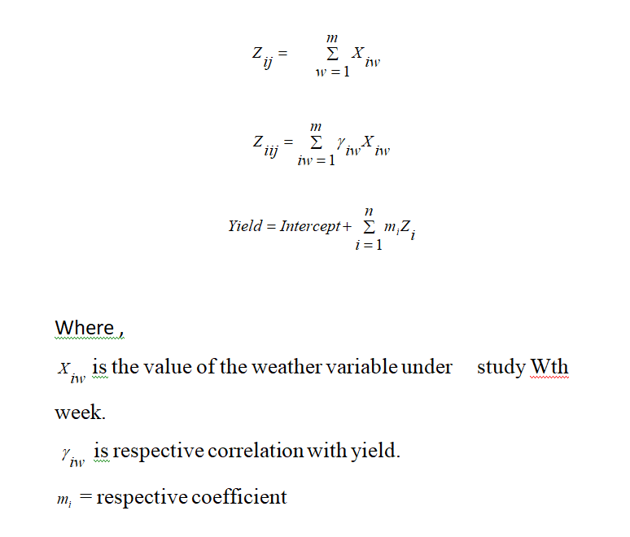
Equation used:

Slide 6
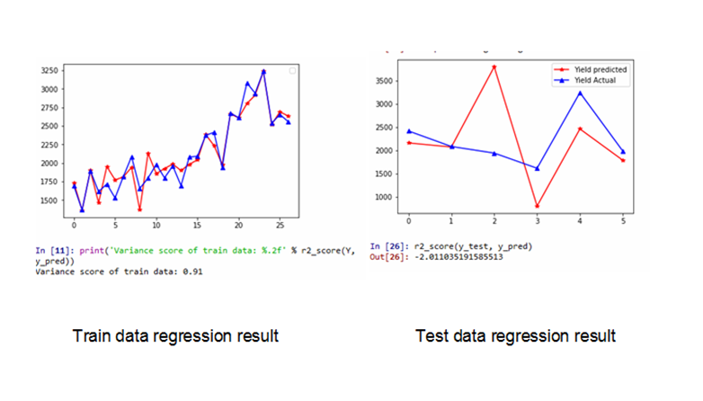
Results

